Slide 1

Micro-Controllers
UTD – STEM - GIRLS

Slide 2
Handy Web Sites and Materials
Raspberry Pi Pico:
https://www.raspberrypi.com/documentation/microcontrollers/micropython.html
Thonny:
Connects computer to Raspberry Pi
https://thonny.org/
Stephens’ GitHub Site
https://github.com/tgsteph/UTD-STEM-PICO
Contains this information and projects
Wiki and PDF version of ‘Get Started with MicroPython’

Slide 3
Session Events
What is a micro-controller?
What’s in the box?
Preparing your Raspberry Pi PICO
Programming with MicroPython
Your first program
Fun Projects

Slide 4
Preparing Your PICO
Install
Install Thonny onto Computer
Download install file from website
Install Software and set Options
Load
Load Python from Raspberry PI
Download file from website
Copy Onto PICO (and it will Reboot)
Run
Run Thonny
Connect computer to Raspberry Pi

Slide 5
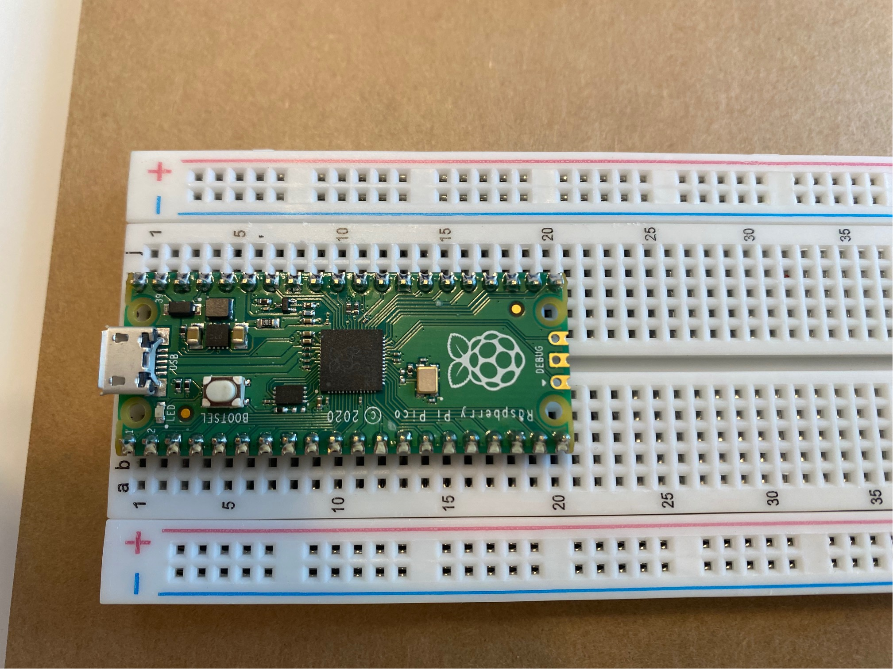
A Raspberry PICO (and project board)

Slide 6
Programming Your PICO
Your first Python program: Hello World
Input: What’s Your Name
Control PICO’s LED: PICOOnOff
Push Buttons: ButtonPush
Game: ReactionGame
Internet of Things: BurglarBuzzer

Slide 7
What Is Next?
Hundreds of web sites with fun and educational projects for Raspberry PICO.
Thank you and enjoy the rest of your day!

